Slide 1
Bapatla Engineering College::Bapatla
Department of Information Technology
Project Review-II
on
Online Car Rental System
By
Pothamsetty Hari Prasad-Y22AIT497
Shaik Nagoor Basha-Y22AIT508
Vanja Sasi Kumar-Y22AIT521
Madasani Sasi Kiran-Y22AIT468
Under the Esteemed Guidance
Of
P. Ratna Prakash M. Tech,(Ph.D)
Assistant Professor

Slide 2
Title
Online Car Rental System

Slide 3
Table of Contents
Abstract
System Architecture
Methodology
Partial Implementation

Slide 4
Abstract
The Online Car Rental System is a full-stack web application designed to streamline the vehicle rental process. It allows users to register with driving license verification, browse and filter cars, and book vehicles with automatic price calculation. The system ensures secure authentication and prevents overlapping bookings through availability checks. An admin panel enables efficient management of users, cars, and bookings. Built using MVC architecture, the application improves efficiency, security, and user experience in car rental services.

Slide 5
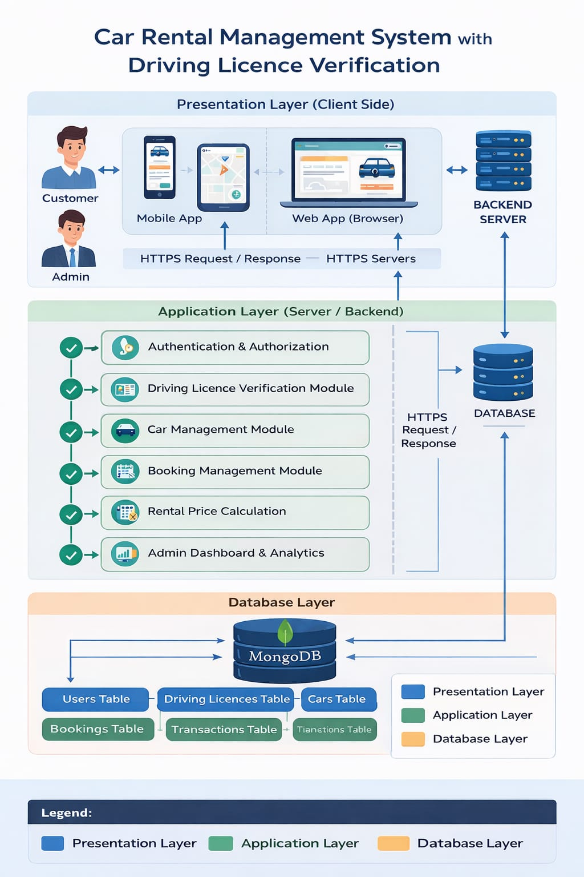
System Architecture

Slide 6
Methodology
The methodology of the Online Car Rental System begins with user registration and driving license verification to ensure authenticity. After successful login, users can browse, search, and filter available cars based on their preferences. The system checks car availability and allows users to book vehicles by selecting rental dates, with automatic price calculation. Admin manages users, cars, and bookings through a dashboard, ensuring smooth operation and efficient system management.

Slide 7
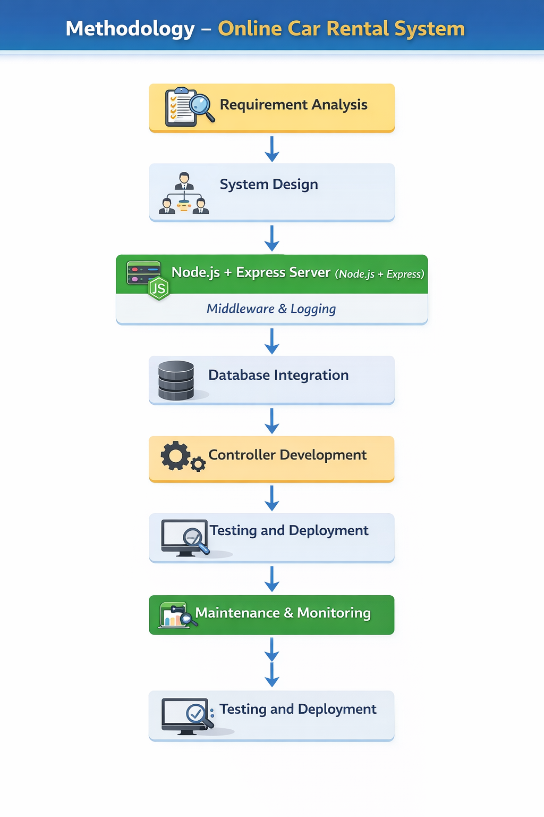

Slide 8
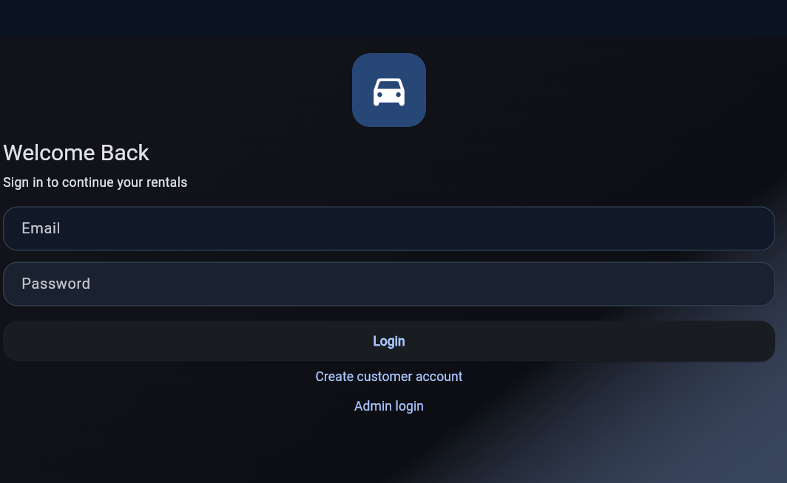
Partial Implementation

Slide 9
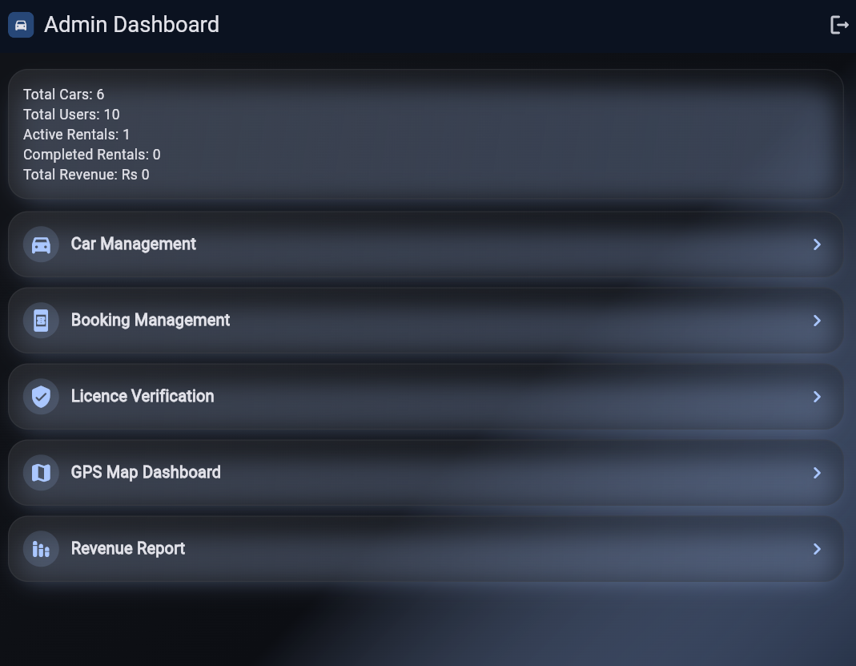

Slide 10
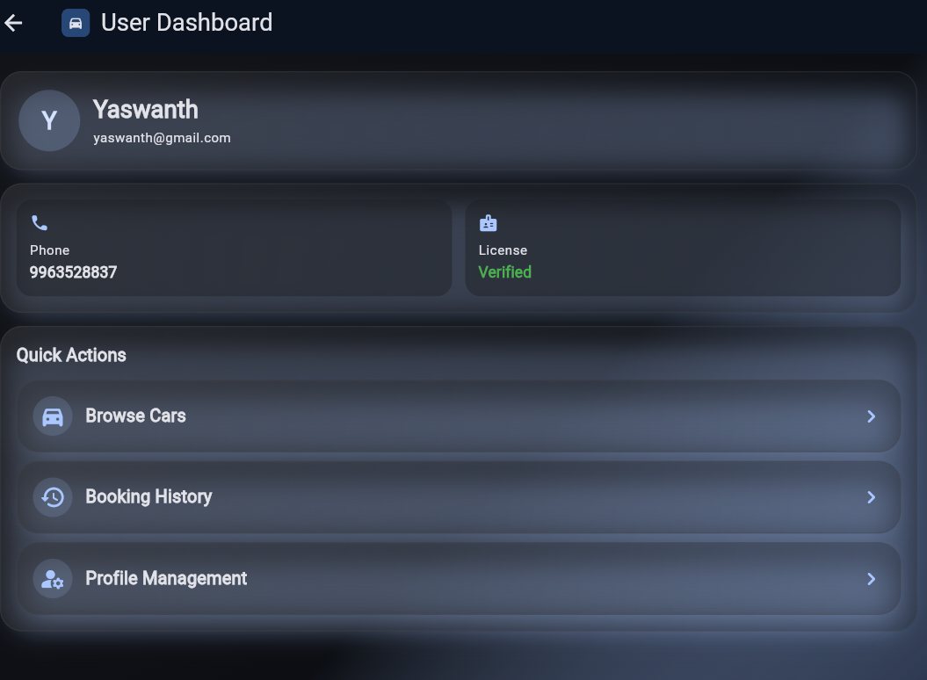

Slide 11
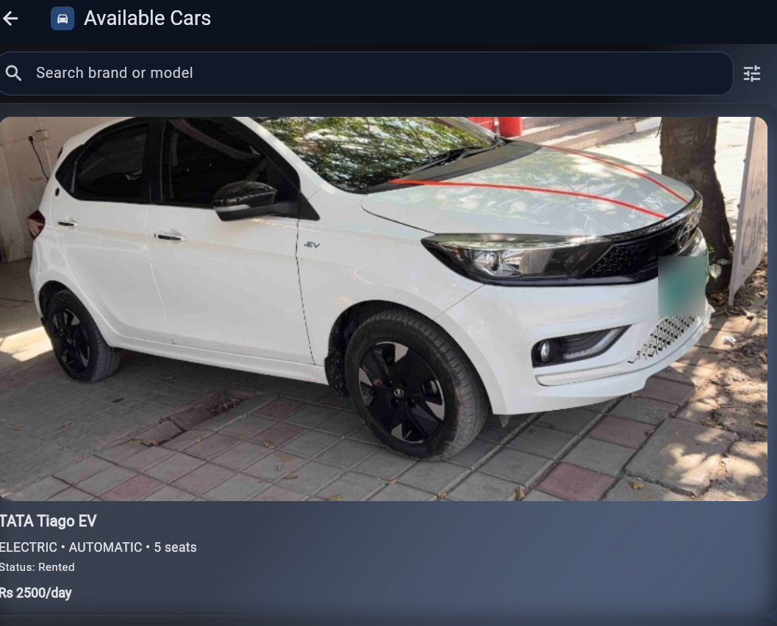

Slide 12
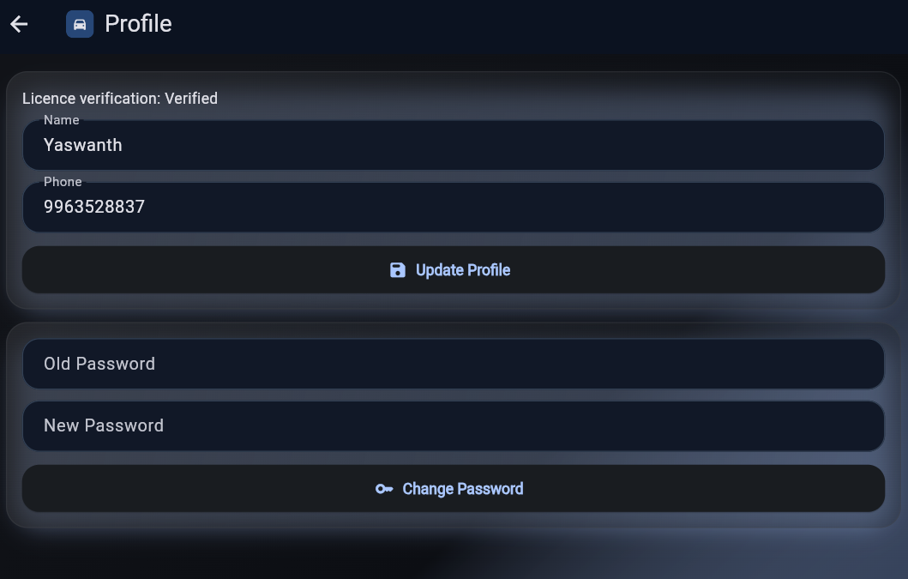

Slide 13
Any Recommendations?

Slide 14


